Slide 1
Particle trajectory in field
Lecture 8

Slide 2
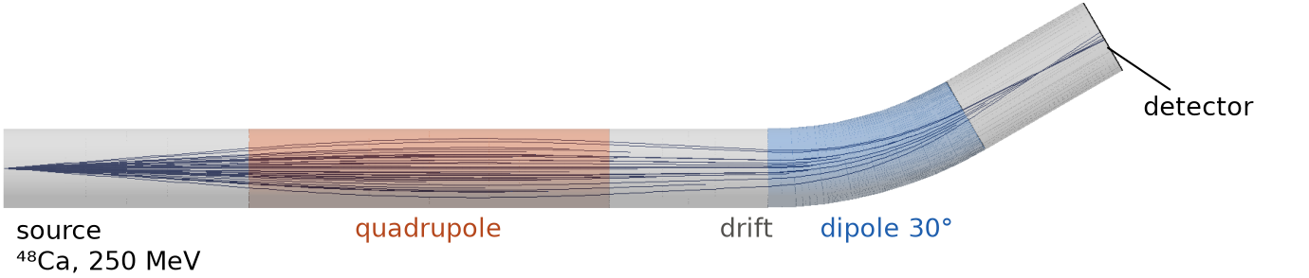
This lecture
We will learn how Geant4 models particle motion in fields!
Until now charged particles flew along straight lines between interactions
In a field they move along curves – also between interactions!
It is done by the transportation process: it integrates the equation of motion numerically
We will learn how to set up this integration in Geant4 and how to define its precision
Our example: a small beamline for ions – quadrupole, 30° dipole and a detector plane
We will look at two field models: ideal field from Geant4 classes and calculated field map with points on some grid!

Slide 3
Equation of motion
Lorentz force – non-relativistic case:
$$m\frac{dv}{dt}=q\left(E+v×B\right), \frac{dr}{dt}=v$$
Pure magnetic field: force is perpendicular to velocity – $\left|p\right|$ and energy don’t change, only direction
Uniform field – circle (or helix if $p$ has a component along $B$) with radius $ρ=\frac{p_{⊥}}{\left|q\right| \left|B\right|}$
The sign of $q$ determines the bending direction. In a nonuniform field we solve the equations numerically
For the non-relativistic case, there are six coupled equations:
$$\frac{d}{dt}\left(\begin{matrix}x \\ y \\ z\end{matrix}\right)=\left(\begin{matrix}v_{x} \\ v_{y} \\ v_{z}\end{matrix}\right), \frac{d}{dt}\left(\begin{matrix}v_{x} \\ v_{y} \\ v_{z}\end{matrix}\right)=\frac{q}{m}\left(\begin{matrix}E_{x}+v_{y}B_{z}−v_{z}B_{y} \\ E_{y}+v_{z}B_{x}−v_{x}B_{z} \\ E_{z}+v_{x}B_{y}−v_{y}B_{x}\end{matrix}\right)$$
To solve them we integrate every equation, e.g.
$$dx=v_{x} dt ⇒ x\left(t\right)=x\left(t_{0}\right)+\int_{t_{0}}^{t}{v_{x}\left(t′\right) dt′}$$

Slide 4
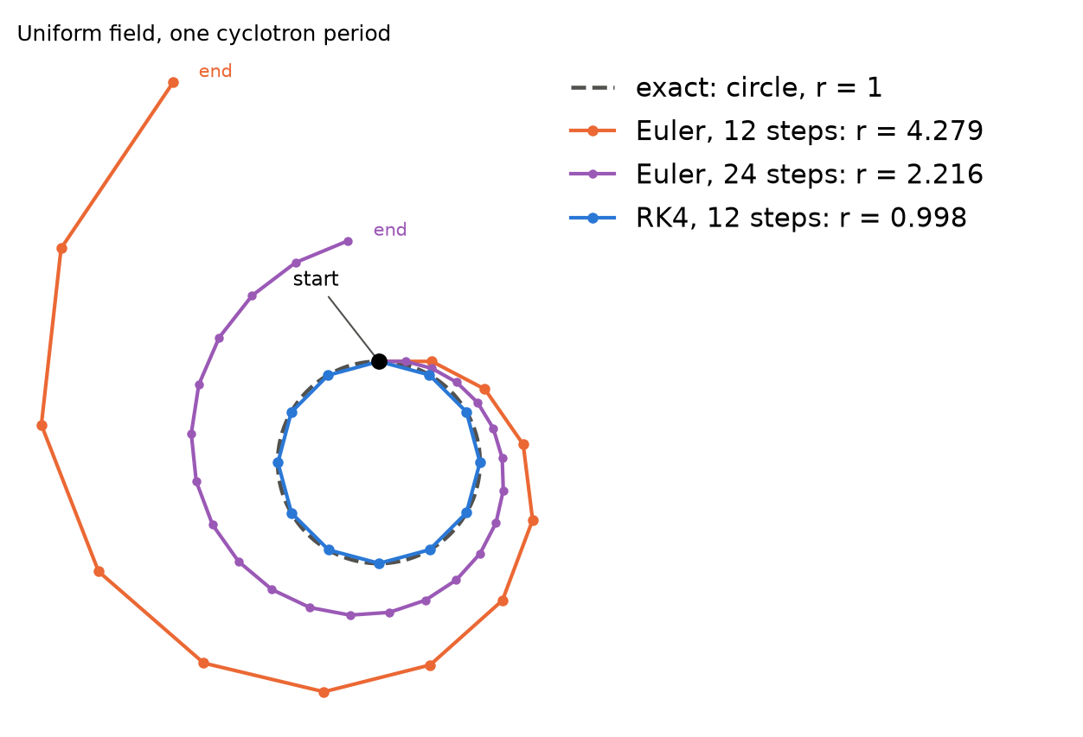
Numerical solution – Euler method
In the numerical methods we solve these integrals by dividing $t$ in very small steps
We know position and velocity at the start and want to get to the next step
Simplest way – just move along the velocity ($h$ – step in time):
$$\begin{aligned}x_{n+1}&=x_{n}+hv_{x,n} \\ v_{x,n+1}&=v_{x,n}+ha_{x,n}\end{aligned}$$
Use the old state for both, then repeat!
But error is quite large: error of one step ~ $h^{2}$, of the whole path ~ $h$
In a magnetic field every step leaves the circle a bit to the outside – the particle spirals out
Picture: after one exact cyclotron period Euler is at $r$ = 4.28 with 12 steps per turn, 2.22 with 24 steps – instead of 1

Slide 5
Numerical solution – Runge–Kutta method
More precise method - estimates derivative numerically 4 times at each step!
Write all equations as ${dY}/{dt}=f\left(Y\right)$. RK4 combines four estimates:
$$\begin{aligned}k_{1}&=f\left(Y\right)& k_{2}&=f\left(Y+h/2k_{1}\right) \\ k_{3}&=f\left(Y+h/2k_{2}\right)& k_{4}&=f\left(Y+hk_{3}\right)\end{aligned}$$
$$Y\left(t+h\right)=Y+\frac{h}{6}\left(k_{1}+2k_{2}+2k_{3}+k_{4}\right)$$
Four derivative evaluations for a basic RK4 step. Error estimation needs extra work
Error of the whole path changes as $h^{4}$: twice smaller step – 16 times smaller error
Same 12 steps per turn: $r$ = 0.998 after one turn
G4ClassicalRK4 – it was the Geant4 default up to version 10.3

Slide 6
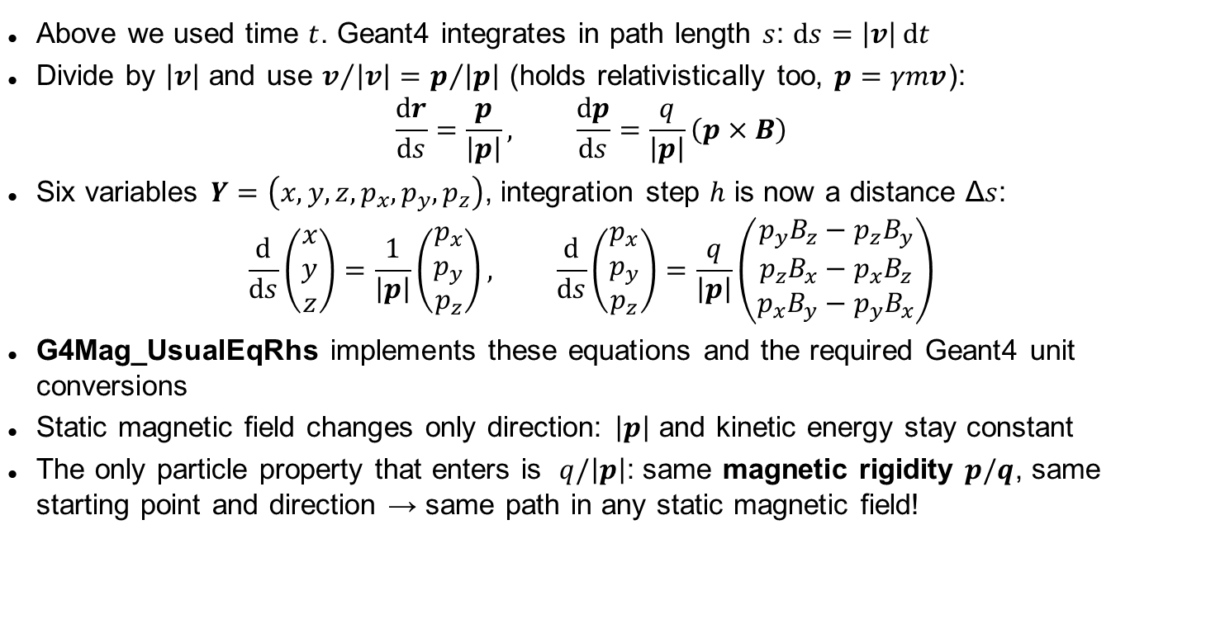
From time to path length
Above we used time $t$. Geant4 integrates in path length $s$: $ds=\left|v\right| dt$
Divide by $\left|v\right|$ and use $v/{\left|v\right|}=p/{\left|p\right|}$ (holds relativistically too, $p=γmv$):
$$\frac{dr}{ds}=\frac{p}{\left|p\right|}, \frac{dp}{ds}=\frac{q}{\left|p\right|}\left(p×B\right)$$
Six variables $Y=\left(x,y,z,p_{x},p_{y},p_{z}\right)$, integration step $h$ is now a distance Δ$s$:
$$\frac{d}{ds}\left(\begin{matrix}x \\ y \\ z\end{matrix}\right)=\frac{1}{\left|p\right|}\left(\begin{matrix}p_{x} \\ p_{y} \\ p_{z}\end{matrix}\right), \frac{d}{ds}\left(\begin{matrix}p_{x} \\ p_{y} \\ p_{z}\end{matrix}\right)=\frac{q}{\left|p\right|}\left(\begin{matrix}p_{y}B_{z}−p_{z}B_{y} \\ p_{z}B_{x}−p_{x}B_{z} \\ p_{x}B_{y}−p_{y}B_{x}\end{matrix}\right)$$
G4Mag_UsualEqRhs implements these equations and the required Geant4 unit conversions
Static magnetic field changes only direction: $\left|p\right|$ and kinetic energy stay constant
The only particle property that enters is $q/\left|p\right|$: same magnetic rigidity $p/q$, same starting point and direction → same path in any static magnetic field!

Slide 7
How Geant4 writes it
We don’t need to write the numerical solver ourselves – Geant4 provides the equation, steppers and driver: https://geant4.web.cern.ch/documentation/dev/bfad_html/ForApplicationDevelopers/Detector/electroMagneticField.html
For a magnetic field, inherit G4MagneticField and implement GetFieldValue(point, Bfield). It writes B at the requested global position.
Pre-built fields: G4UniformMagField, G4QuadrupoleMagField, G4SextupoleMagField, G4UniformElectricField. A field map – you write the class yourself (as we do)
Be careful with units! B must be in Geant4 units: Bfield[1] = 1.5*tesla. The internal unit is 1000 T – a bare 1.5 means 1500 T!
For electric or combined field you should use G4ElectroMagneticField
For our magnetic field we use equation class G4Mag_UsualEqRhs(field). For an electric or combined field - G4EqMagElectricField
Stepper: advances the state and estimates its numerical error. We use G4DormandPrince745 – upgraded Runge-Kutta with better weights to your derivative estimates and included error calculation

Slide 8
How long should one step be?
We don’t know a good step length in advance: field changes, particles have different momenta
So a simulation must also estimate its own error and change the step during particle transportation!
To control step we use Driver (G4IntegrationDriver):
error bigger than requested (ε) → shorter step, try again
error smaller → next step is longer
G4ClassicalRK4 compares one full step with two half steps, the difference is the error. About 11 derivative evaluations including the initial derivative
Some methods get two answers of different order from one set of evaluations. Their difference is used as the error estimate
G4DormandPrince745 – 5th order answer and 4th order for the error, 7 field evaluations. Geant4 default since 10.4 – fewer field evaluations means faster simulation!

Slide 9
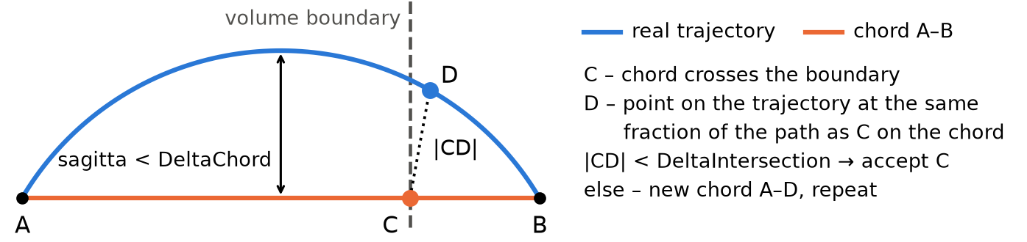
Where does it cross a volume boundary? Chords
Navigator can only intersect straight lines with volumes
So Geant4 replaces the curved path by straight chords – G4ChordFinder
The sagitta of each chord must be smaller than DeltaChord (default 0.25 mm)
A volume can be missed only if the trajectory goes into it less than DeltaChord deep!
If a chord crosses a boundary at C, Geant4 takes point D on the real trajectory (same fraction of the path as C on the chord) and checks |CD| < DeltaIntersection (default 1 µm). If not – new shorter chord, repeat
It’s important for thin detectors in a magnetic field – e.g. silicon pixel layers inside the solenoid of a collider experiment, where hit positions are used to reconstruct tracks

Slide 10
Classes: from field to volume
each object goes into the constructor of the next:
Field G4MagneticField
provides B at a point – GetFieldValue()
field = new G4UniformMagField(B);
Equation G4Mag_UsualEqRhs
sets equation of motion: dY/ds
equation = new G4Mag_UsualEqRhs(field);
Stepper G4DormandPrince745
one integration step + error estimate
stepper = new G4DormandPrince745(equation);
Driver G4IntegrationDriver
chooses step length for required accuracy
driver = new G4IntegrationDriver<G4DormandPrince745>(
minStep, stepper, stepper->GetNumberOfVariables());
Chord finder G4ChordFinder
splits the path into chords for boundary crossing
chordFinder = new G4ChordFinder(driver);
Field manager G4FieldManager
unites field + chord finder, attaches to a volume
fieldManager = new G4FieldManager(field, chordFinder);
logicalVolume->SetFieldManager(fieldManager, true);

Slide 11
Physics step and integration steps
Remember lecture 3: every process proposes a step length, the shortest wins
Transportation proposes the step to the next volume boundary. In a field it is the length along the curved path
One physics step can contain many field integration steps! You don’t see them in SteppingAction – you get only the start and the end of the physics step
Physics defines the physics step – not the accuracy of integration. Accuracy has its own parameters!
In vacuum without step limiter one step could go through the whole volume with field – curved and correct, but you would have only two points of it!

Slide 12
Accuracy parameters
Is the trajectory right? – integration accuracy
DeltaOneStep (G4FieldManager, default 0.01 mm) – allowed position error at the end of a physics step which doesn’t cross a boundary
For every physics step of length L Geant4 uses the relative error ε = DeltaOneStep / L: every Runge–Kutta step h must have position error < ε·h, momentum error < ε·|p|
EpsilonMin / EpsilonMax (default 5·10⁻⁵ / 10⁻³) – limits of ε. If DeltaOneStep / L is outside, ε is set to the limit and the error target becomes ε·L instead of DeltaOneStep.
In the project: 10⁻⁵ / 10⁻⁴: 10 mm step → ε = 0.01/10 = 10⁻³ → gets limited to 10⁻⁴ → target error is 1 µm, stricter than DeltaOneStep. A 10 m step would get ε = 10⁻⁵ → 0.1 mm, looser
Minimum step (driver, 0.01 mm here) – the driver never makes integration steps shorter than this, and steps this short are made without the accuracy check. It does not limit physics steps
Is the geometry seen right? – navigation accuracy
DeltaChord (G4ChordFinder, default 0.25 mm) – maximal sagitta of a chord: a volume closer than DeltaChord to the path is not missed. Small value – many chords, simulation becomes expensive!
DeltaIntersection (G4FieldManager, default 1 µm) – accuracy of the boundary crossing point. Cheap – only for steps crossing a boundary
Together
The two groups are independent. Geant4 docs: DeltaOneStep and DeltaIntersection should not differ by more than 10 times. Different volumes can have different field managers – and different accuracy!
Side effect: DeltaChord also limits the step length where the path curves – like the step limiter

Slide 13
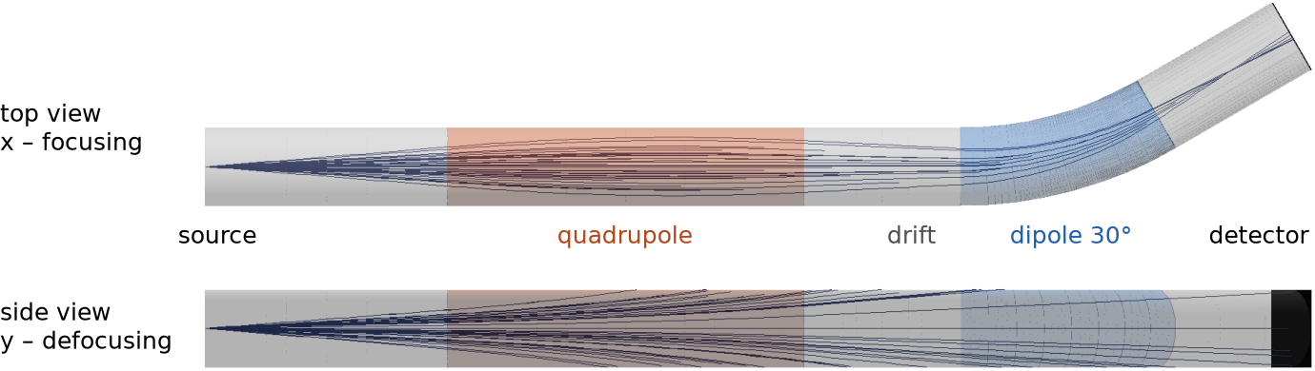
Example project: ion beamline
Goal: transport ⁴⁸Ca¹⁷⁺ ions (250 MeV, 5° cone) through a quadrupole and a 30° dipole and see how many reach the detector and where do they land
Two models of the same quadrupole: ideal field (G4QuadrupoleMagField) and calculated field map of a real magnet (DGFRS-2 Q1)
A quadrupole focuses in one plane and defocuses in the other – picture: the same ions from the top and from the side
Vacuum, only transportation and a step limiter – ions which hit the tube wall are counted as lost

Slide 14
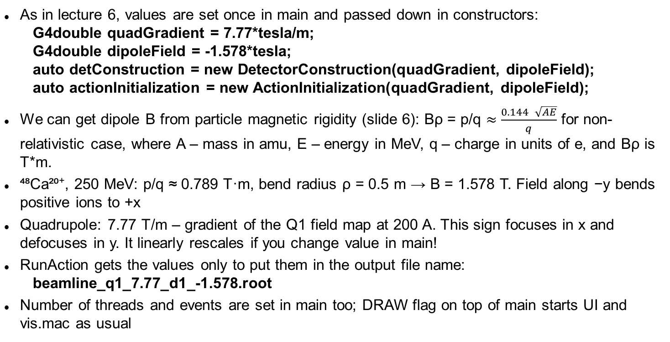
Parameters from main
As in lecture 6, values are set once in main and passed down in constructors – fields and bend radius to DetectorConstruction, the ion to PrimaryGeneratorAction:
G4int ionZ = 20, ionA = 48; G4double ionEnergy = 250.*MeV;
G4double quadGradient = 7.77*tesla/m; G4double bendRadius = 0.5*m;
G4double Brho = 0.144*std::sqrt(ionA*E)/dipoleCharge*tesla*m;
G4double dipoleField = -Brho/bendRadius;
We can get dipole B from particle magnetic rigidity (slide 6): Bρ = p/q $≈$ $\frac{0.144\sqrt{AE}}{q}$ for non-relativistic case, where A – mass in amu, E – energy in MeV, q – charge in units of e, and Bρ is T*m.
⁴⁸Ca¹⁷⁺, 250 MeV: p/q ≈ 0.928 T·m, bend radius ρ = 0.5 m → B = 1.856 T. Field along −y bends positive ions to +x. For 16+ and 17+ together the dipole is set for q = 16.5 → B = 1.912 T
Quadrupole: 7.77 T/m – gradient of the Q1 field map at 200 A. This sign focuses in x and defocuses in y. It linearly rescales if you change value in main!
RunAction gets the values only to put them in the output file name:
beamline_q1_7.77_d1_-1.85581.root
Number of threads and events are set in main too; DRAW flag on top of main starts UI and vis.mac as usual

Slide 15
Geometry: six vacuum volumes
Six connected vacuum volumes (G4_Galactic) cover the beam path, tube radius 50 mm, world is invisible:
input – quadrupole – quadrupole exit – dipole – dipole exit – detector
Dipole: G4Torus segment, bend radius 0.5 m, 30°. Rotated so that it bends in the x–z plane; the exit tube and the detector are rotated by 30° too
Detector: box 100 × 100 × 0.6 mm at the end of 200 mm exit tube
Two quadrupole options – #define in DetectorConstruction.cc. Tube lengths input / quadrupole / exit:
IDEAL_QUADRUPOLE: 310 / 456 / 200 mm
FIELD_MAP: 218 / 640 / 108 mm
Quadrupole centre (z = 537 mm) and dipole entrance (z = 965 mm) are the same in both – results can be compared directly!
Every volume gets G4UserLimits(10*mm) – maximal step, more about it later

Slide 16
Three ways to set up a field
1. Shortcut – creates equation, stepper and driver with default settings (example B5). Only for pure magnetic field:
fieldManager->CreateChordFinder(field);
2. G4FieldBuilder – new in 11.3. You give it the field, it creates everything, parameters can be changed with UI commands /field/setDeltaChord, /field/stepperType ... (examples field01, field03):
fieldBuilder->SetLocalField(field, logicalVolume);
fieldBuilder->ConstructFieldSetup();
3. Build the whole chain yourself – full control, works in old versions too
We do the third way – to see every piece

Slide 17
ConstructSDandField()
Fields are created here, like sensitive detectors in lecture 7: it is called for every worker thread, each thread gets its own field and field manager
Construct() saves quadrupole and dipole logical volumes and the quadrupole centre in class members to pass them to fields
IDEAL_QUADRUPOLE or FIELD_MAP chooses the quadrupole field class
Dipole – uniform field along y:
auto* dipoleField = new G4UniformMagField(G4ThreeVector(0., fDipoleField, 0.));
Attach field manager to logical volume, true – also add field to all daughters:
fQuadLV->SetFieldManager(CreateFieldManager(quadField), true);
Field is only inside the volume – sharp edge at the boundary!
Local field gets global coordinates! Your field class must move them to magnet coordinates itself!

Slide 18
CreateFieldManager() – our helper
We create helper function which creates and returns G4FieldManager with same parameters to dipole and quadrupole – just not to write it all twice:
G4FieldManager* DetectorConstruction::CreateFieldManager(G4MagneticField* field)
{
auto* equation = new G4Mag_UsualEqRhs(field);
auto* stepper = new G4DormandPrince745(equation);
auto* driver = new G4IntegrationDriver<G4DormandPrince745>(minStep, stepper,
stepper->GetNumberOfVariables());
auto* chordFinder = new G4ChordFinder(driver);
chordFinder->SetDeltaChord(0.25*mm);
auto* fieldManager = new G4FieldManager(field, chordFinder);
fieldManager->SetDeltaOneStep(0.01*mm);
fieldManager->SetDeltaIntersection(0.001*mm);
fieldManager->SetMinimumEpsilonStep(1.e-5);
fieldManager->SetMaximumEpsilonStep(1.e-4);
}
Minimum step is 0.01 mm. One helper for both magnets, each gets its own objects
Another stepper – change the stepper class and the driver template: G4ClassicalRK4, G4CashKarpRKF45, G4BogackiShampine23 ...

Slide 19
Field classes
G4UniformMagField(G4ThreeVector B) – same B everywhere
G4QuadrupoleMagField – Geant4’s ideal quadrupole: the same linear field in the whole volume, hard edge, no fringe fields. Our QuadrupoleFieldMap (next slide) is the real magnet from a calculated map
G4QuadrupoleMagField(G, origin, rotation) – B_{x} = G·y, B_{y} = G·x, B_{z} = 0 around the origin, in rotated axes. Rotation can’t be nullptr – it is used without check, the program crashes! We pass new G4RotationMatrix() – identity, no rotation. How to rotate – see comments in the code
Sign of G: for positive ions flying along +z, G > 0 focuses in x and defocuses in y. We use G = +7.77 T/m
Own field – inherit G4MagneticField and implement one method:
void GetFieldValue(const G4double point[4], G4double* Bfield) const override;
point – global x, y, z and time; Bfield – write B_{x}, B_{y}, B_{z} in global coordinates and in Geant4 units (multiply by tesla!)

Slide 20
Our field map: QuadrupoleFieldMap
Calculated map of the DGFRS-2 quadrupole Q1 at 200 A: file 200.txt, 55 MB. CMake copies it to the build directory
53 × 53 × 161 points with a 5 mm step: x, y from −130 to 130 mm, z from −400 to 400 mm. First line: nx ny nz; then each line: x y z B_{x} B_{y} B_{z} (mm and T)
The constructor reads the file into 3 tables – once per thread, at initialization
GetFieldValue(): gets the point in Geant4 global coordinates, moves it to the magnet coordinates (origin in the magnet centre), finds the grid cell and interpolates from its 8 corners (trilinear). Outside the map B = 0
GetFieldValue() is called very often – it should be efficient!
If your magnet is rotated, be careful: transform the point to local coordinates, interpolate there, and rotate the field components back to global coordinates – see our GetFieldValue()
The field is scaled linearly: B × G / (−7.77 T/m) – the map has −7.77 T/m, so our G = +7.77 T/m flips its polarity
Reading and interpolation are based on the Geant4 example advanced/nanobeam (TabulatedField3D)
Fast enough: GetFieldValue() gets the cell index directly from the position (no search) and sums 8 corners – a few dozen multiplications! Memory ≈ 11 MB per thread

Slide 21
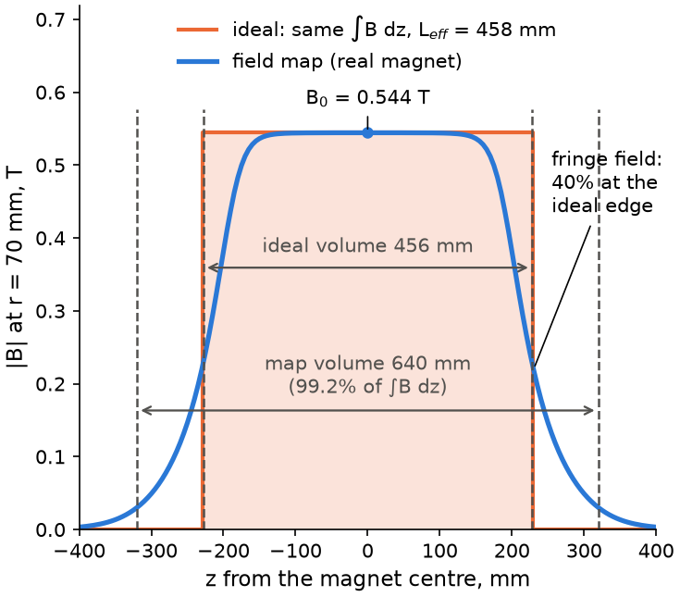
Effective length: ideal vs real quadrupole
Real magnets have fringe fields at the edges. For calculations they are typically replaced by an ideal magnet with effective length L_{eff}
Same field integral – approximately the same effect on the trajectory – so the effective length is calculated as: L_{eff} = ∫B dz / B₀
B – |B| along a line parallel to the axis (dipole – on the axis, quadrupole – at some radius r), B₀ – its value in the magnet centre
From our field map: r = 70 mm, B₀ = 0.544 T (G = 7.77 T/m), L_{eff} = 458 mm. If we take any r from 10 to 100 mm we get almost the same effective length!
The fringe field is still 40% of B₀ at the ideal edge – the map volume must be longer, that’s why geometry changes between flags in DetectorConstruction!
Only an approximation: the 1° ion reaches the dipole at 5.03 mm (ideal) and 5.25 mm (map) – the field shape matters too!

Slide 22
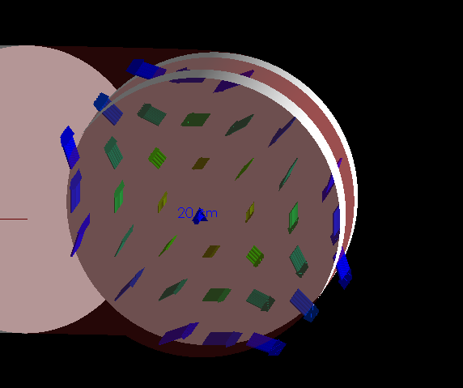
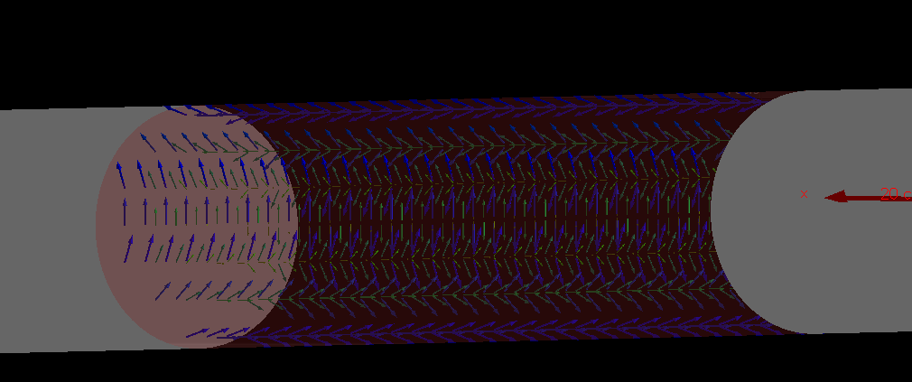
Drawing the field
Geant4 can draw the magnetic field as arrows – a quick check of polarity, rotation and where the field is. It draws the field Geant4 really uses to transportation. Uncomment in vis.mac:
/vis/scene/add/magneticField 15 fullArrow
n (default 10) – sample points per half of the largest dimension of the drawn region, the same spacing in all directions: larger n = more and smaller arrows, and more time to render!
Arrow length ∝ |B|. Colour – relative to the maximum |B| in the region: blue – strongest, green – half, red – weakest. lightArrow – lines instead of arrows (faster)
By default the whole scene is sampled ! Limit it to a volume or a box:
/vis/set/volumeForField QuadrupolePV – use the physical volume name here
Drawings for ideal quadrupole case:

Slide 23
Physics list – step limiter
Two pieces, both needed:
G4UserLimits(10*mm) – attached to every beamline logical volume. It only stores the number
G4StepLimiter process – reads it and proposes this step length
Registered for GenericIon in our own PhysicsList – all ions share its processes:
ph->RegisterProcess(new G4StepLimiter(), G4GenericIon::GenericIon());
User limits of a logical volume doesn’t go to daughter volumes!
It only limits the step and does nothing else – no random sampling: every step is 10 mm, except steps which end on a volume boundary
The same in a modular physics list: RegisterPhysics(new G4StepLimiterPhysics()) – only charged particles by default, for neutral ones SetApplyToAll(true)

Slide 24
PrimaryGeneratorAction and data collection
G4ParticleGun at (0, 0, 0), 250 MeV total kinetic energy. GetIon(20, 48) gives fully stripped ⁴⁸Ca²⁰⁺ – we set 17+, typical after the stripper foil of FLNR cyclotrons: SetParticleCharge(17*eplus), after SetParticleDefinition()
Direction sampled uniform in solid angle inside a 5° cone – see the code for details!
#define TWO_CHARGE_STATES (PrimaryGeneratorAction.cc): 16+ or 17+, each with probability 0.5 (G4UniformRand() < 0.5); in main uncomment the dipole line for q = 16.5
Data are collected in SteppingAction – from the volumes before and after the step:
QuadrupoleExitPV → DipolePV: world x, y at the dipole entrance (z = 965 mm) → H2 ID 0
Entry into DetectorPV: position in detector coordinates → H2 ID 1, count transported, kill the track
Entry into WorldPV: the ion hit the wall – count escaped, kill the track
H2: 100 × 100 bins over ±50 mm (1 × 1 mm²). H1 ID 0: step length – 10 mm steps and shorter boundary steps
RunAction merges threads and writes beamline_q1_7.77_d1_-1.85581.root. Check: transported + escaped = number of ions

Slide 25
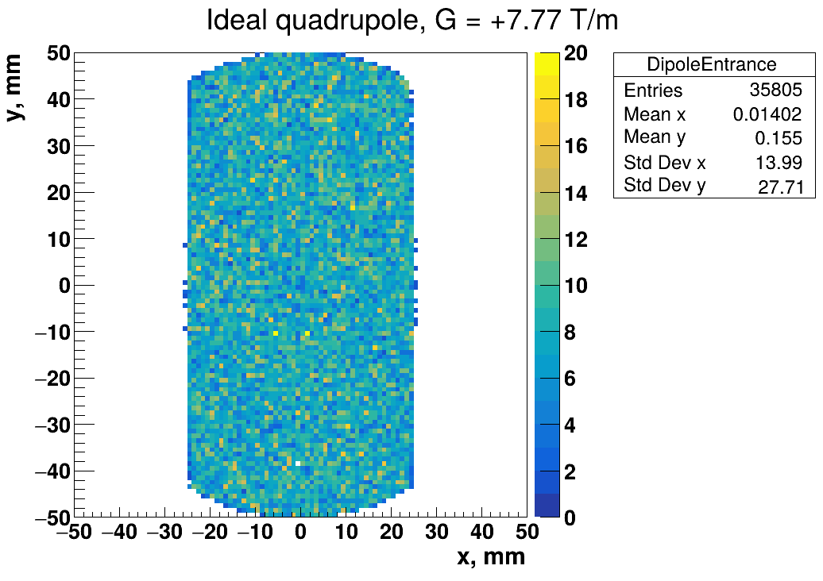
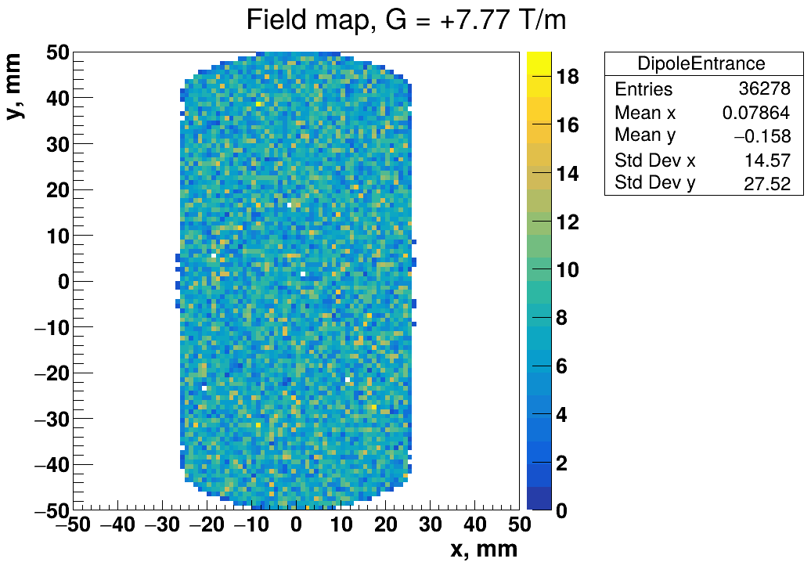
Results: ideal quadrupole vs field map
⁴⁸Ca¹⁷⁺, 10⁵ ions, G = +7.77 T/m – positions at the dipole entrance (z = 965 mm)
Almost the same: 35 805 vs 36 278 ions, Std Dev x 14.0 vs 14.6 mm, y 27.7 vs 27.5 mm. On the detector: 20 200 vs 20 525 ions

Slide 26
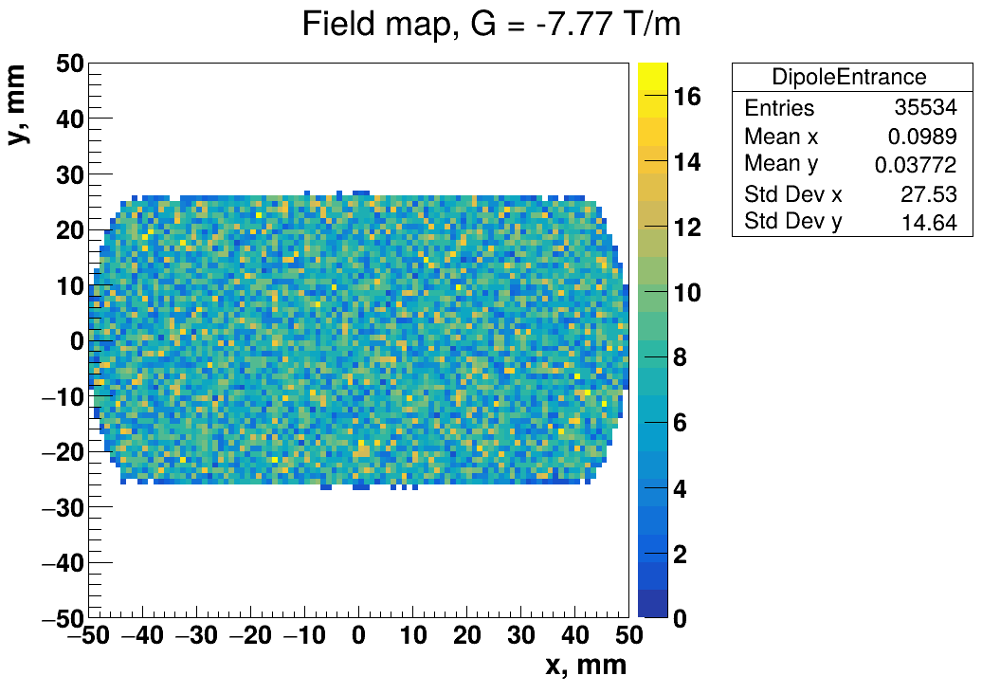
Results: focusing and defocusing
Field map, dipole entrance, only the sign of G is changed: +7.77 T/m focuses in x and defocuses in y, −7.77 T/m – the picture turns by 90°
On the detector: 20 525 ions with +7.77 and 25 813 with −7.77 – the polarity matters for transmission

Slide 27
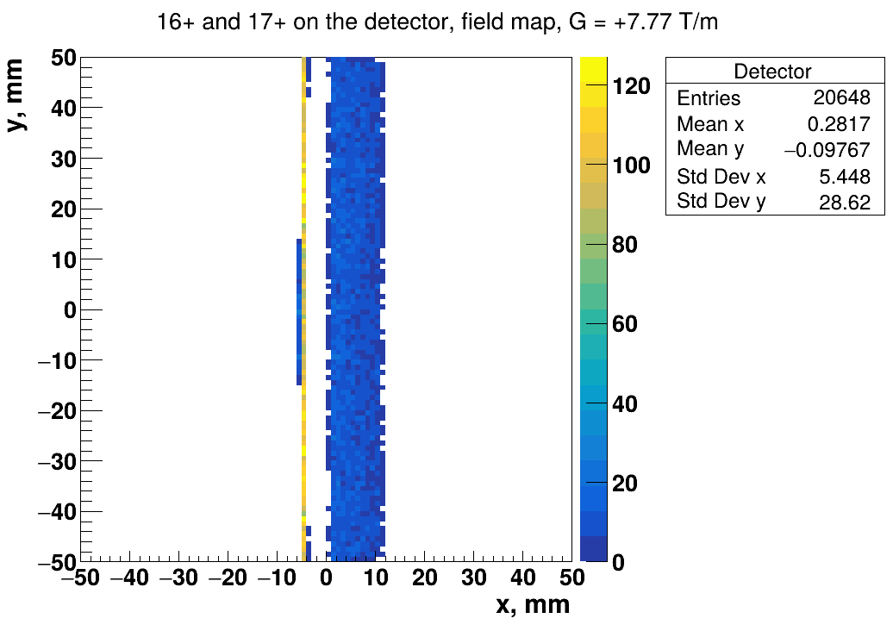
Results: two charge states
#define TWO_CHARGE_STATES: 16+ and 17+ with equal probability, the dipole is set for q = 16.5 (B = 1.912 T)
The dipole separates them by 10 mm in x: 16+ at x = −4.6 mm, 17+ at x = +5.4 mm
The gradient of 7.77 T/m focuses the image in x into vertical lines: 16+ is very thin, 17+ is wider – each charge state is focused at a slightly different gradient!
A beamline is tuned for one charge state – the others fly on different trajectories and are lost or cut by slits!

Slide 28
Some homework if you’d like
In CreateFieldManager() replace G4DormandPrince745 by G4ExplicitEuler – the include, the stepper class and the driver template G4IntegrationDriver<G4ExplicitEuler>. Compare the image on the detector and the simulation time. Why is the image the same?
Comment out G4StepLimiter in PhysicsList and make the accuracy coarser: SetMinimumEpsilonStep(1e-2), SetMaximumEpsilonStep(1e-2), SetDeltaChord(100*mm). Compare Dormand–Prince and Euler again – what happens to the image?
Shoot 16+, 17+ or 18+ with equal probability, keep the dipole set for 17+. Look at the image and compare widths.
Set G = 0 and look at the images at the dipole entrance and on the detector. Compare the number of ions on the detector with G = 7.77 T/m – what does the quadrupole actually do?

